Slide 1
Can Remote Sensing Predict Fire Damage in Plants and Soil Microbial Activity?
Clarisa Avalos
Rachel Gallery and Martha Gebhardt– School of Natural Resources and the Environment
Arizona Space Grant Consortium Symposium, Tucson, Arizona
April 14, 2018

Slide 2
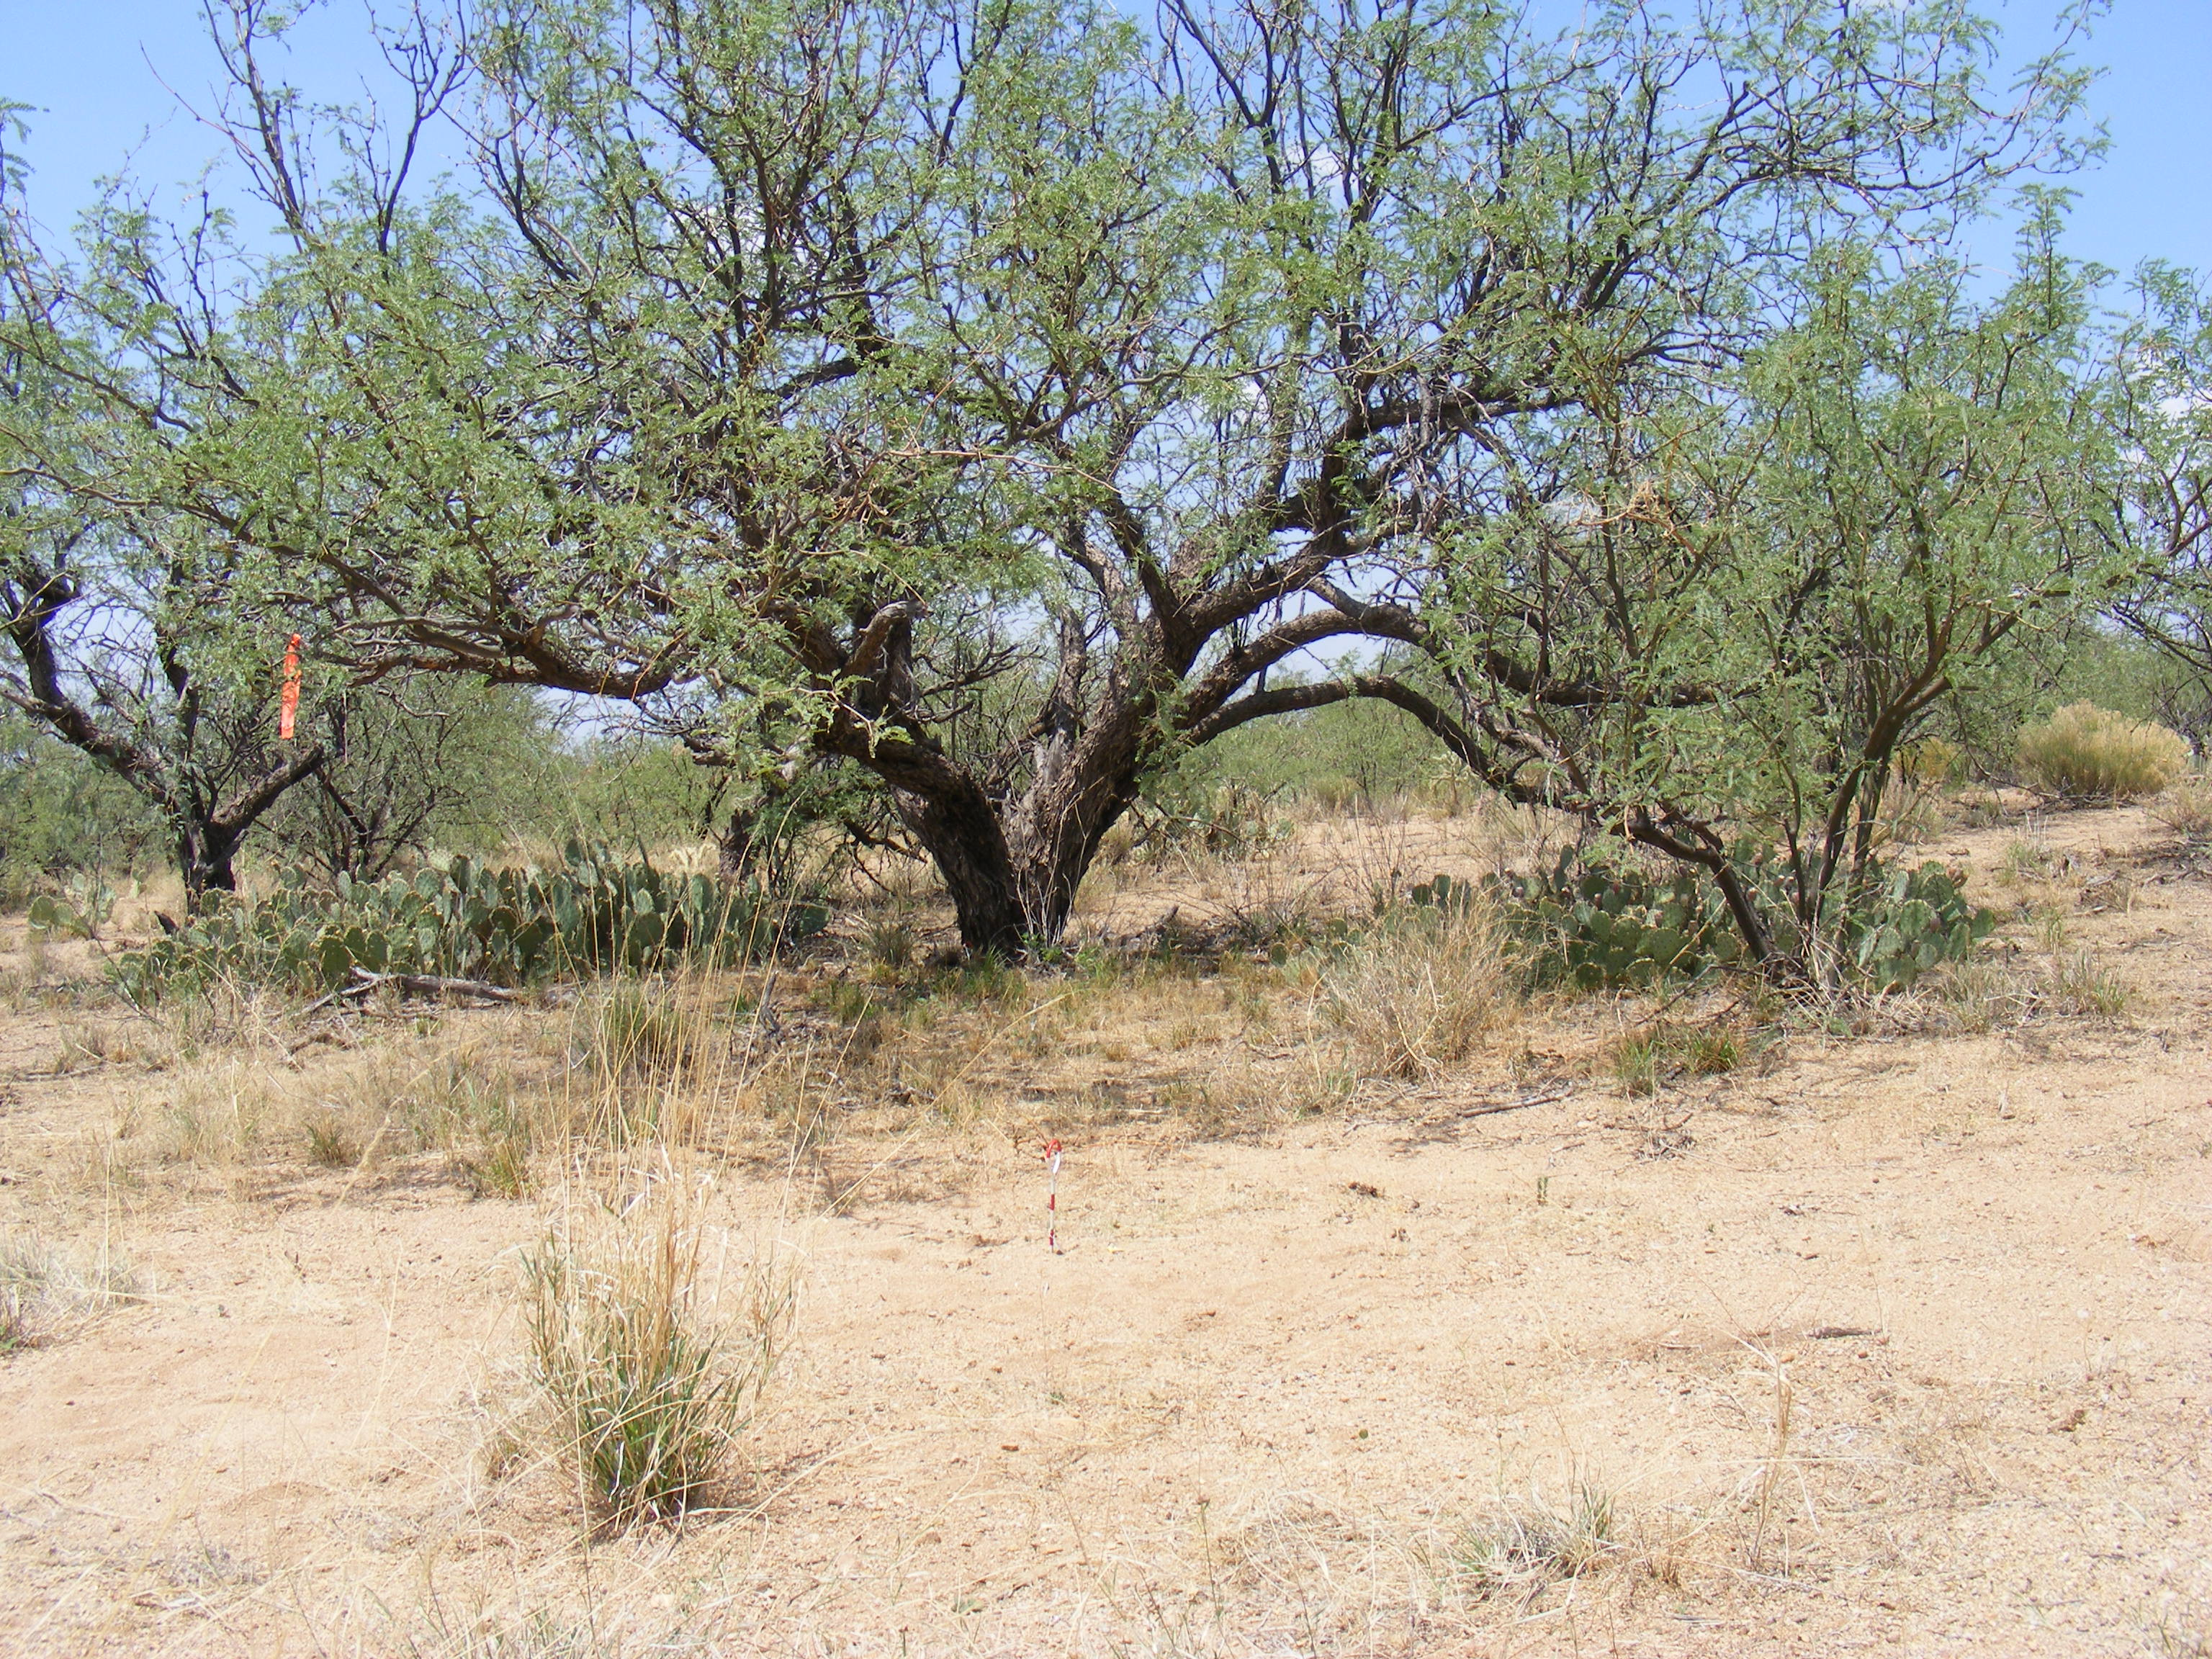
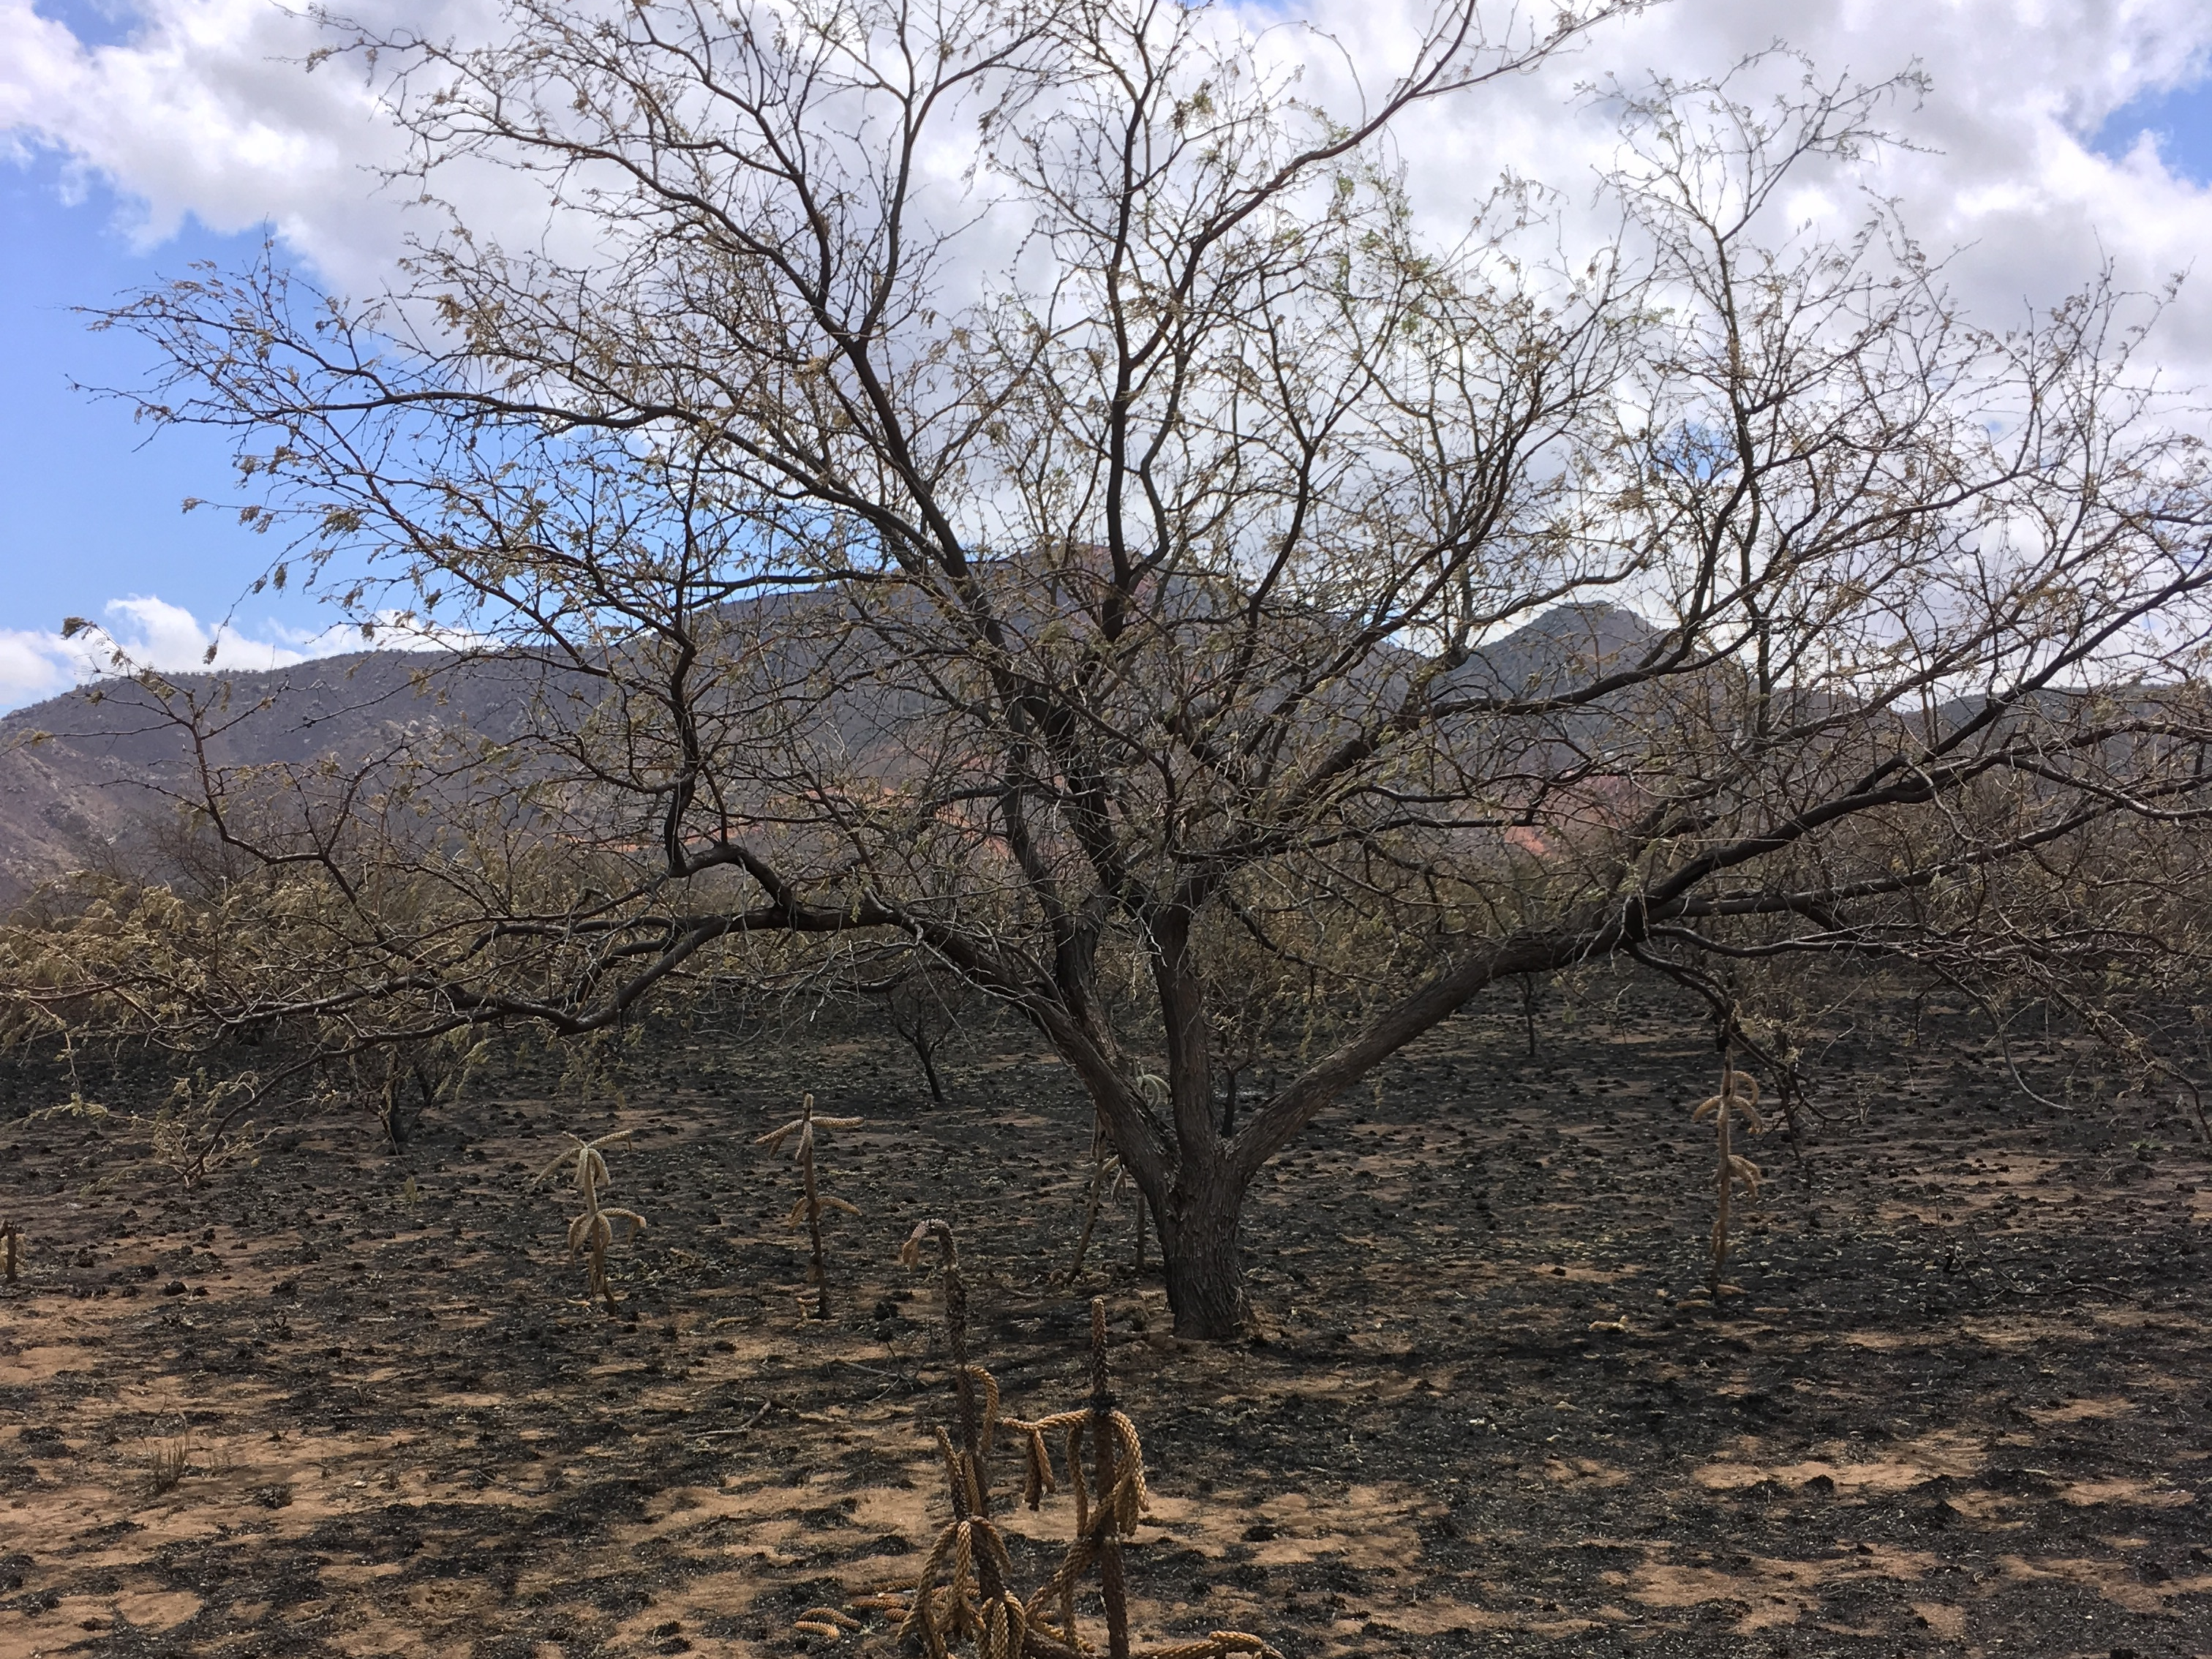
Fire effects
Ground cover loss and tree mortality
Lower albedo
High soil erosion
Loss of organic matter
More alkaline pH

Slide 3
Goals
Use remote sensing to investigate how vegetation recovers after a fire and infer how soil microbial activity responds based on plant regrowth
Determine the relative importance of vegetation and microbial activity in driving fire recovery
Notes:
Understanding the relationship between soil microbial activity and plant regrowth after a fire can be a crucial aspect in recovery planning to prevent soil erosion.
These correlations could be used to determine the ideal timing and locations to plant native vegetation to prevent erosion, if need be, or to predict landscape changes in the absence of management

Slide 4
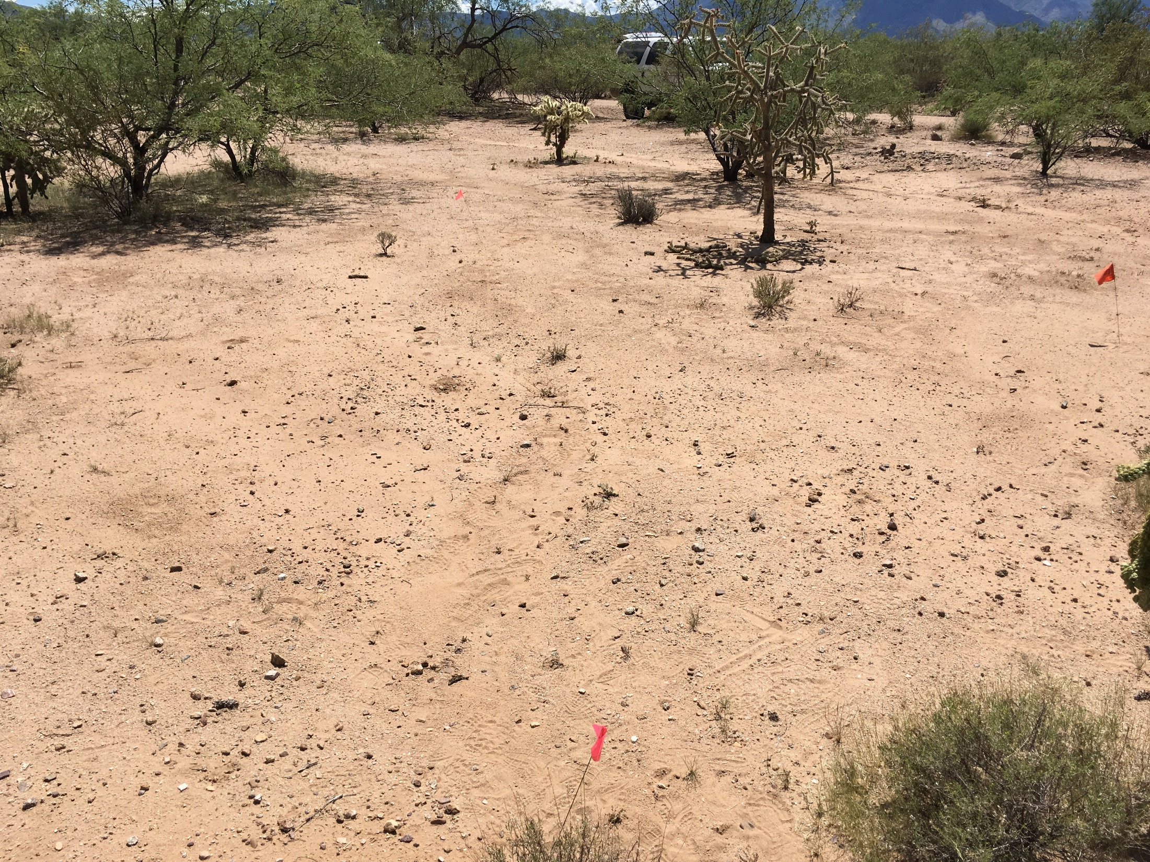
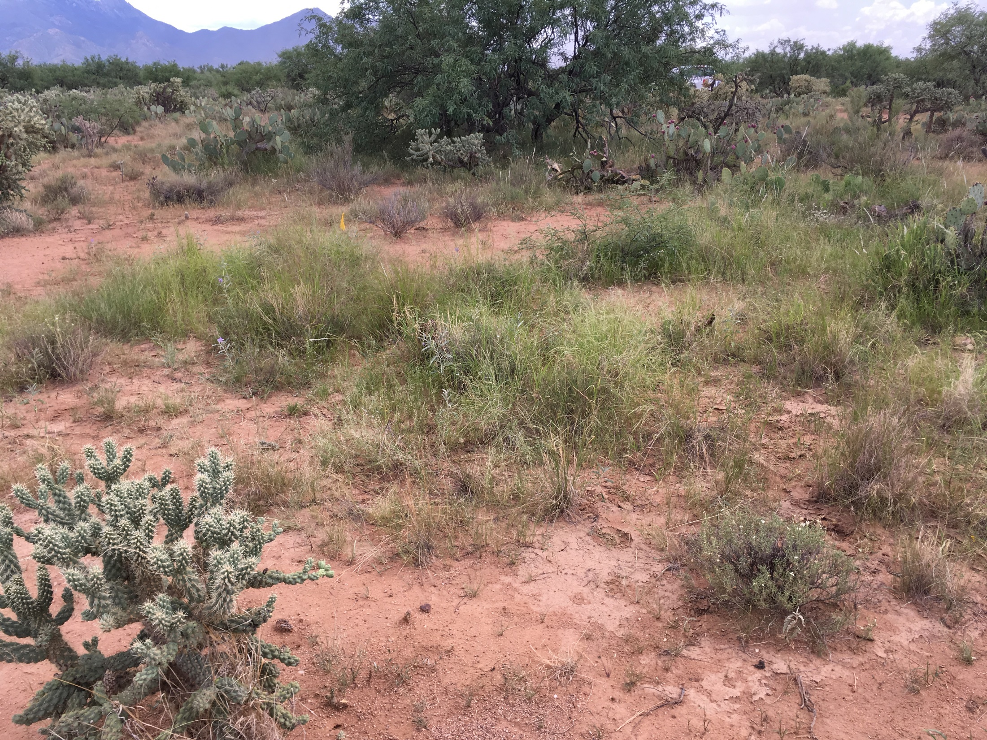
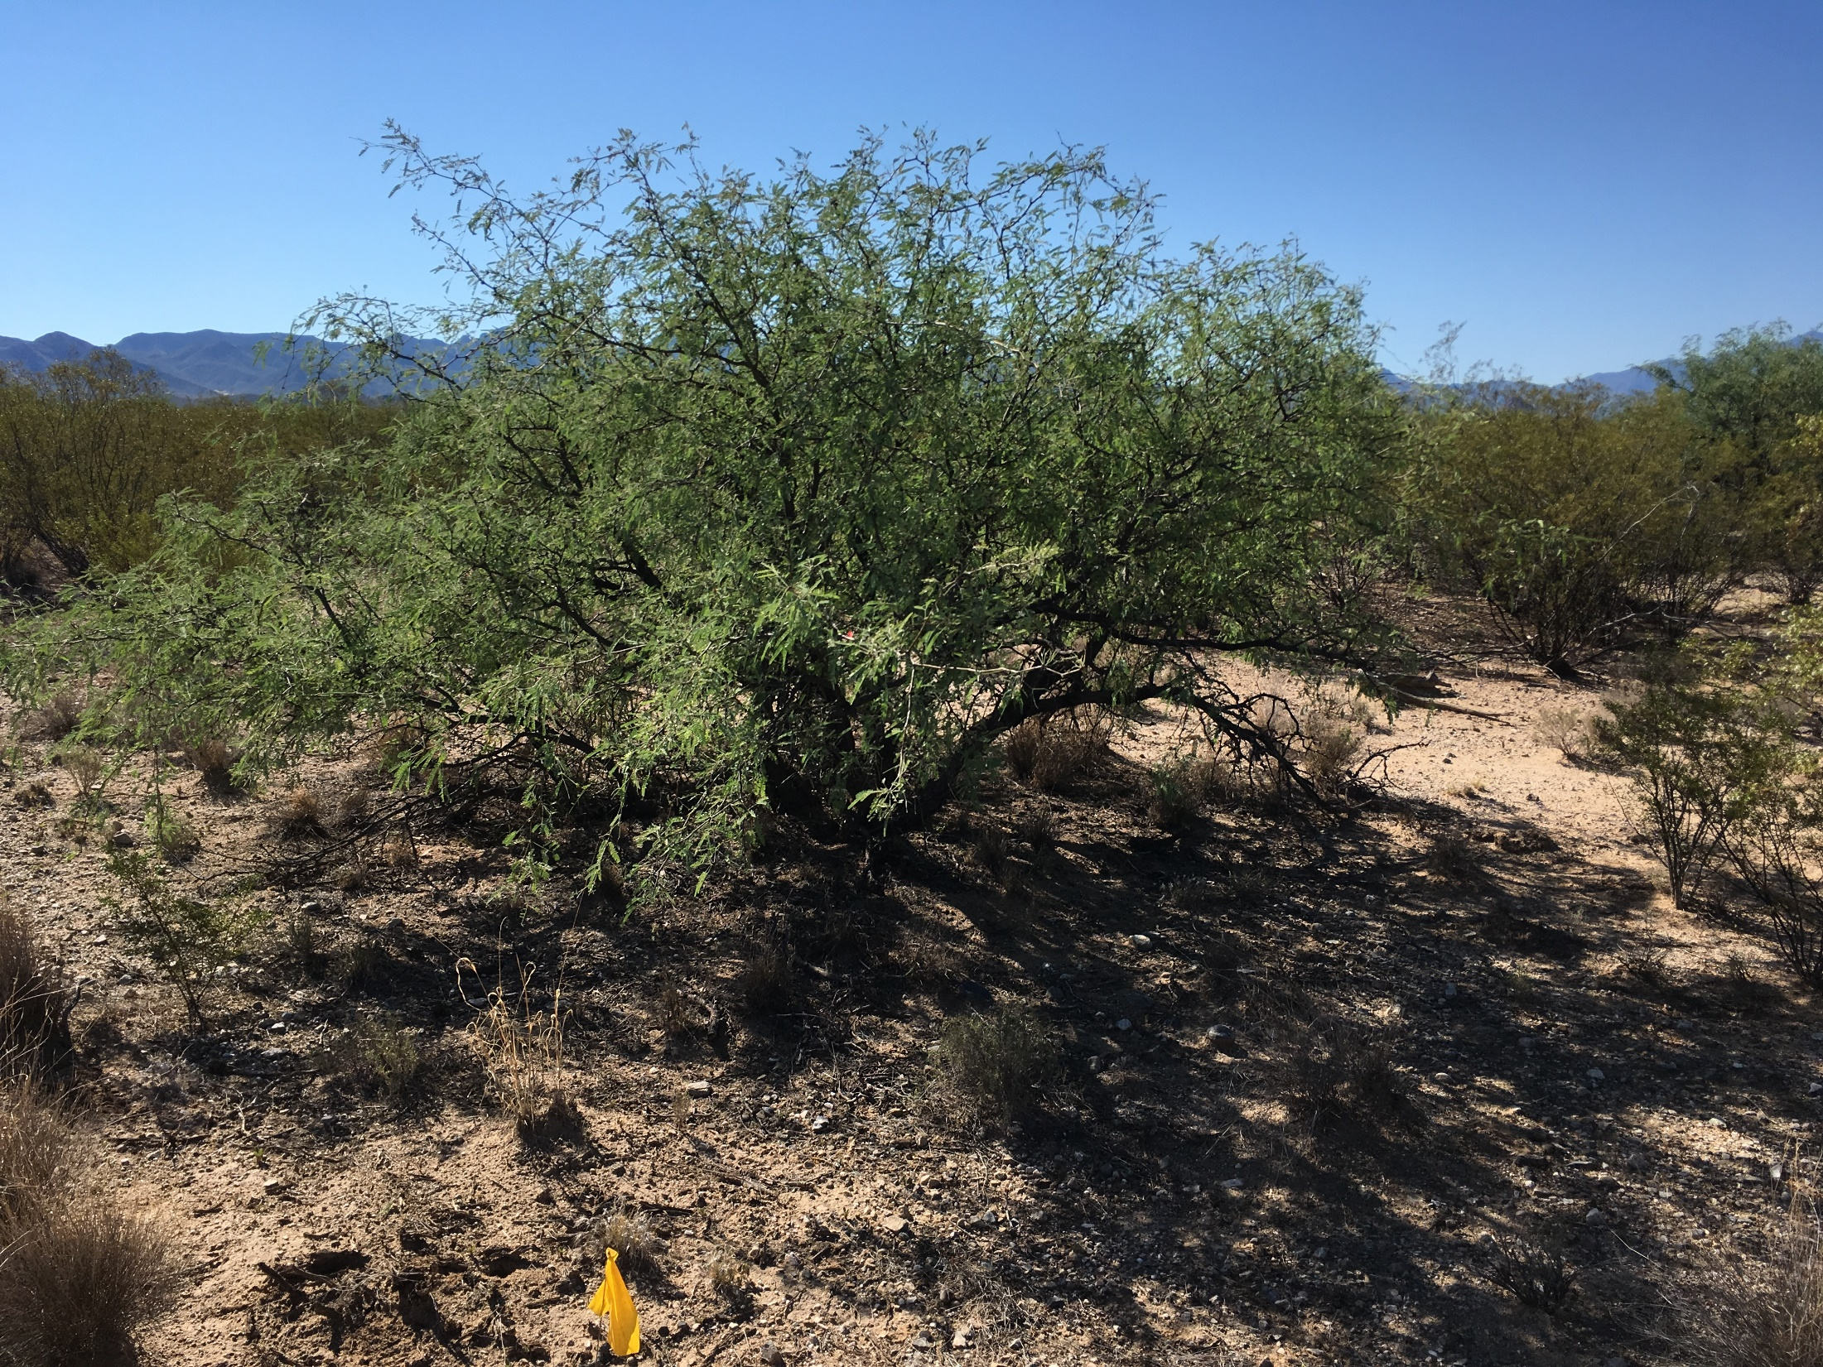
Site History and Sample Collection
Santa Rita Experimental Range
Semi-arid environment
Soils from Pleistocene (25,000 to 2 million years ago) and Holocene/Late Pleistocene (10,000 to 25,000 years before present)
Fires in 1994 and 2017
Bare Soil
Grass Covered Soil
Mesquite covered soil
Notes:
Pleistocene– more clay in soils, appear more red

Slide 5
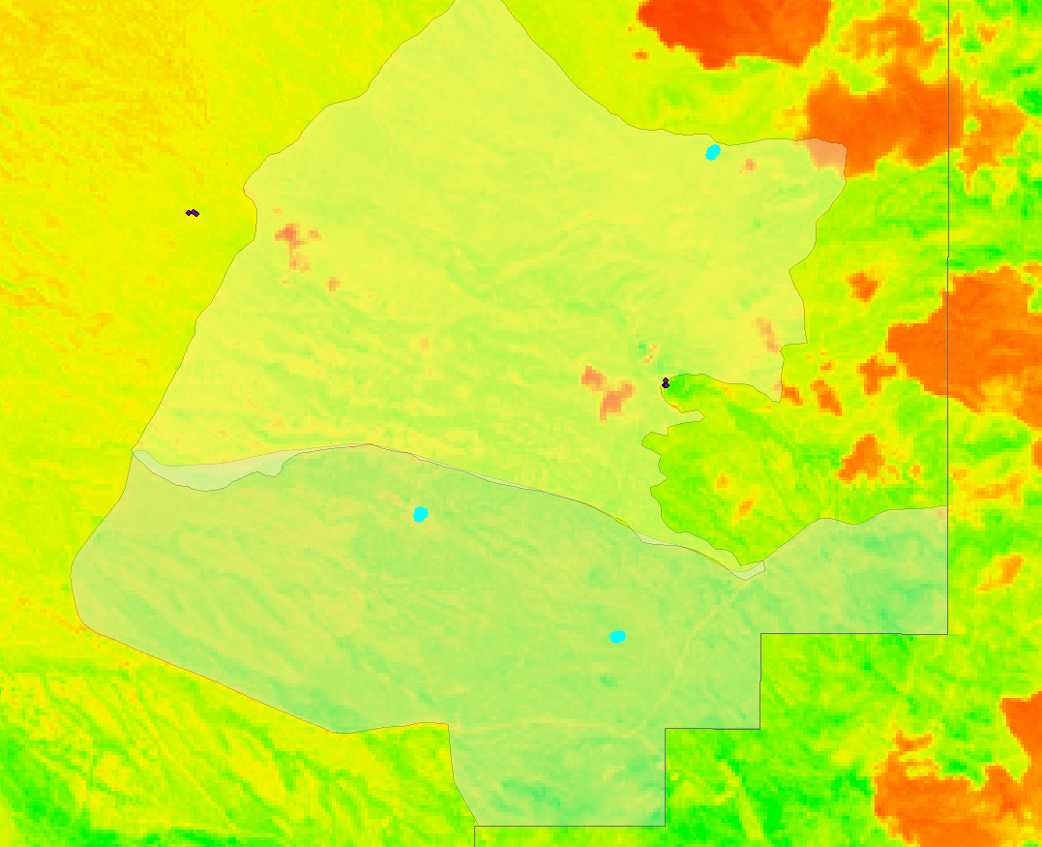
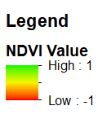
LANDSAT Satellite to study Plant Growth
Dri.edu
30m spatial resolution
Normalized Difference Vegetation Index (NDVI) = plant “greenness”/growth
11 bands
Notes:
30m spatial resolution
70s-today
# of bands (11)
NDVI = plant “greenness”/growth (-1 to +1)
Colors of visible and infrared sunlight reflected by plants

Slide 6
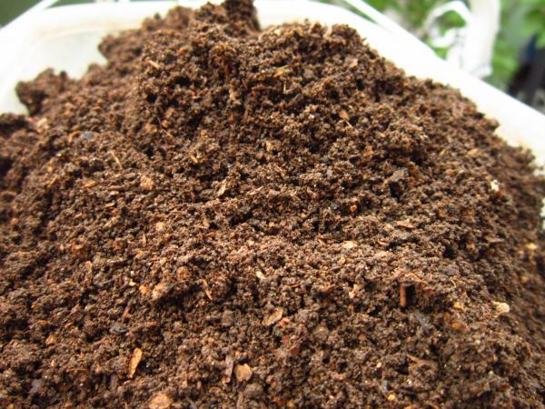
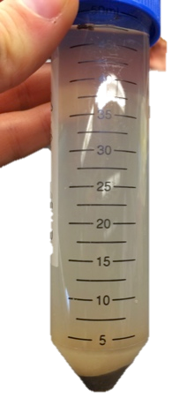
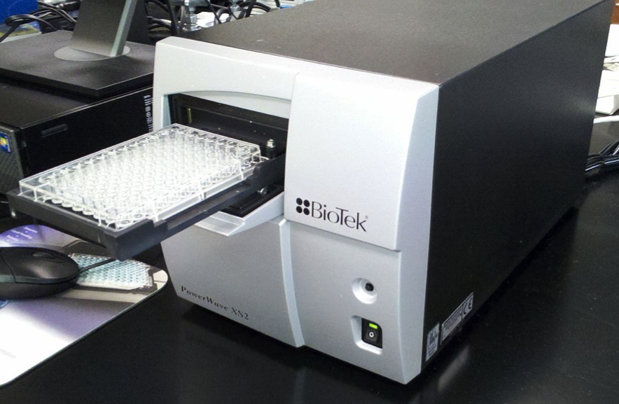
Potential extracellular enzyme activity (EEA)
https://content.ces.ncsu.edu/extension-gardener-handbook/1-soils-and-plant-nutrients
Notes:
Decomposition

Slide 7
No correlation between NDVI and microbial activity
Notes:
Vegetation cover was low directly after a fire and increased over time, but ultimately remained lower than at sites that had not been burned
Dry august. Variability in wetness

Slide 8
NDVI shows plant recovery post fire

Slide 9
Phosphorus activity lowest in young, recently burned soils
A
Carbon
Nitrogen
Phosphorus
A
B
p< 0.05
Old- Pleistocene
Young- Holocene
Notes:
Standard error of the mean
P<0.05

Slide 10
Significant effect of soil age on Nitrogen and Phosphorus activities
*
p< 0.05
*
Old- Pleistocene
Young- Holocene
Carbon
Nitrogen
Phosphorus
Notes:
Influence of soil age on microbial activity: N higher in young soils P higher in old soils

Slide 11
No significant effect of plants on enzyme activities
Notes:
We also predicted that the vegetation type should influence microbial biomass and activity with higher microbial exoenzyme activities predicted near mesquites compared to grass or bare soil.

Slide 12
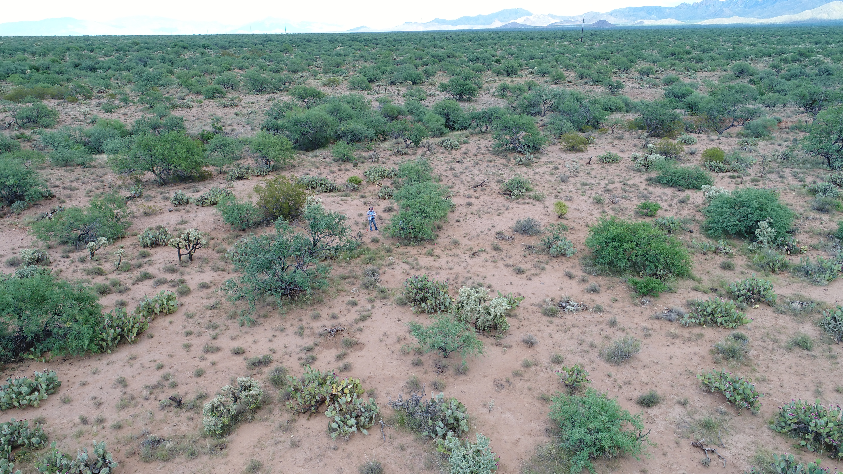
Conclusion
In semi-arid grasslands, NDVI can be used to monitor vegetation recovery post fire
No difference in microbial activities based on vegetation cover
Nitrogen activity highest and Phosphorus activity lowest in younger, recently burned soils
There is not a clear relationship between remotely sensed vegetation cover and in-situ soil biogeochemistry
Notes:
Nitrogen limitation in recently burned soils – volatilization
More that needs to be incorporated to understand the correlations. Soil moisture?

Slide 13
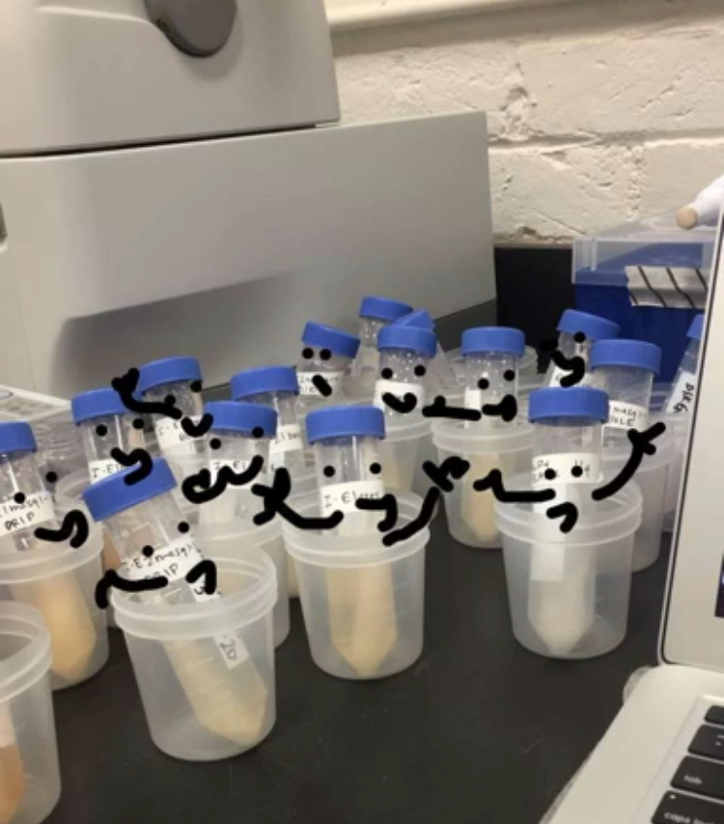
Thank You!

